Slide 1
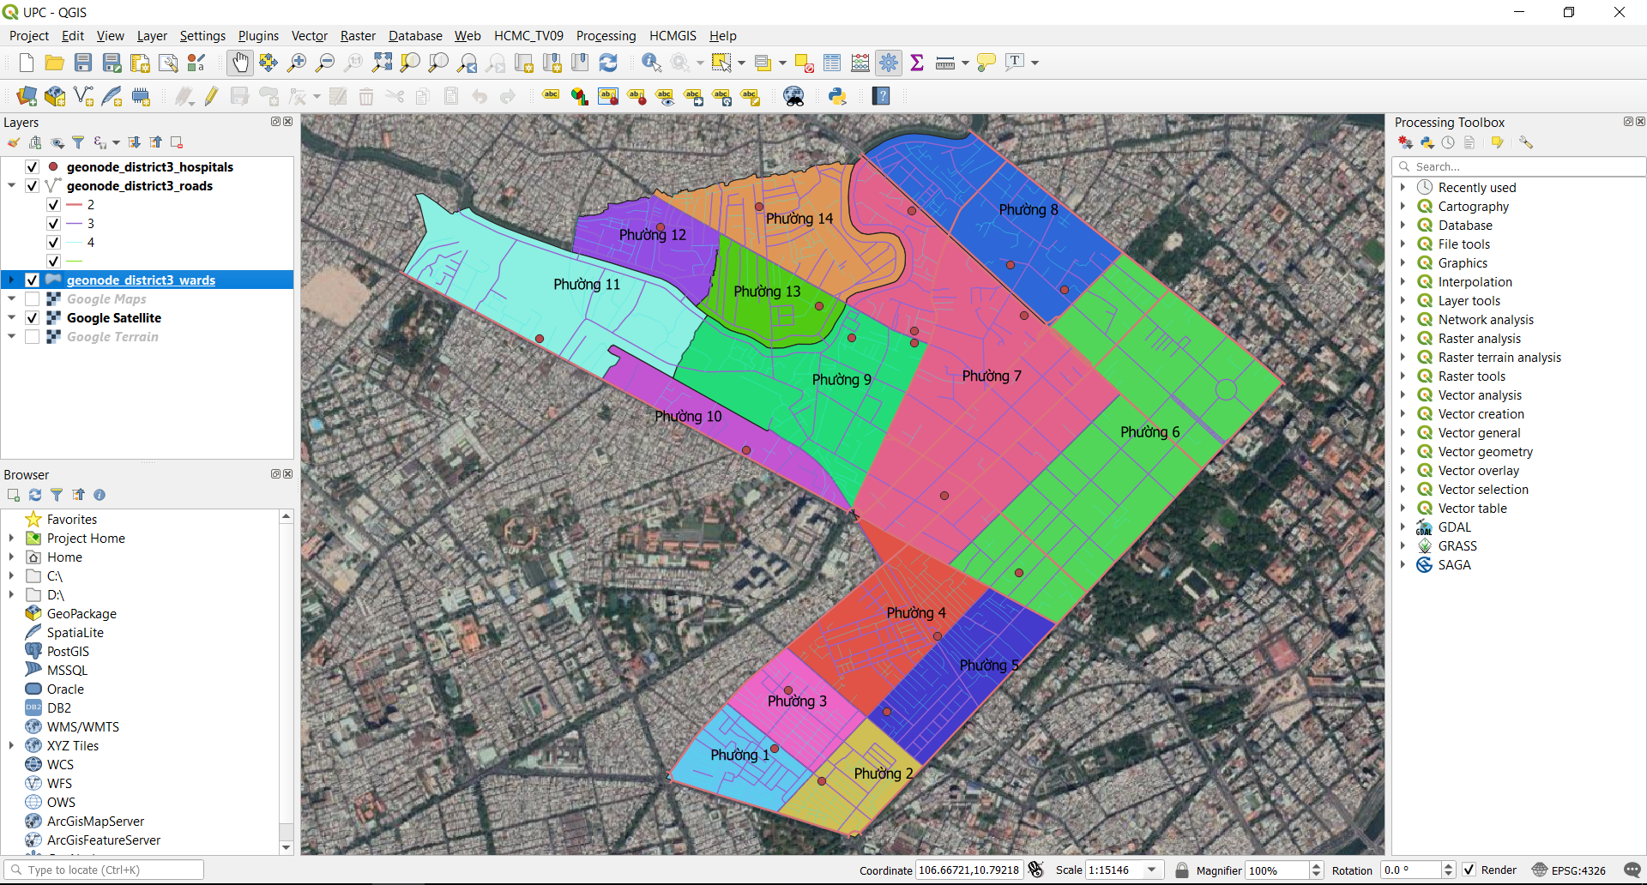
Unit 4: Processing Tools

Slide 2
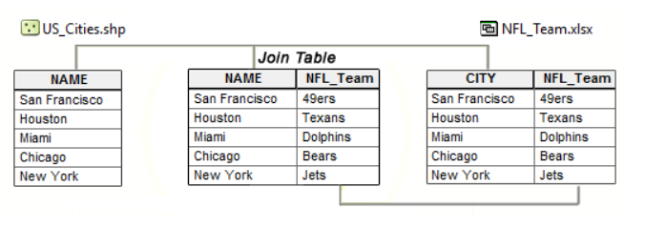
Processing Tools
Attribute joins:
Join/ Append attribute from Table/ Excel files to existing shapefile based on a key field

Slide 3
Processing Tools
Processing tools in Vector menu, Processing Toolbox
Attribute join, Spatial Join
Clip, intersection, union
Check validity, fix geometries

Slide 4
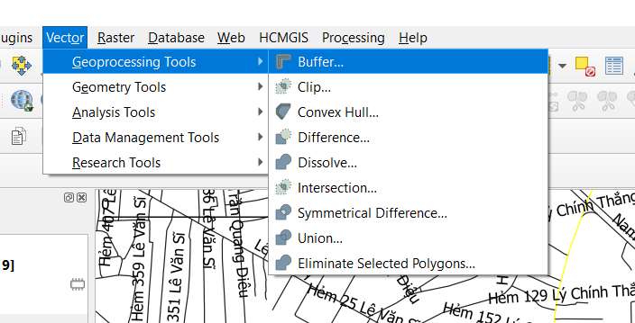
Processing Tools

Slide 5
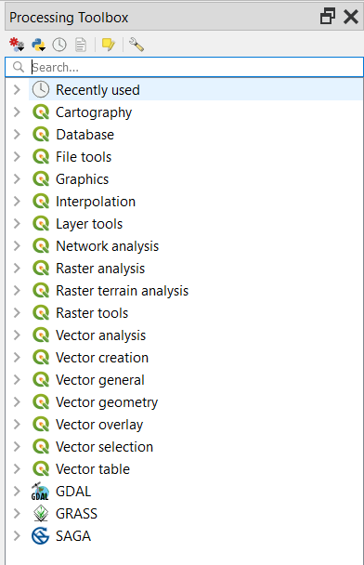
Processing Tools
Processing Toolbox
Search keyword and perform

Slide 6
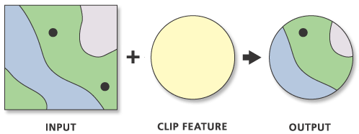
Processing Tools
Clip:

Slide 7
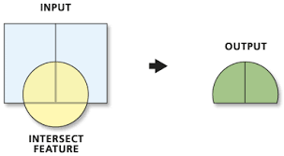
Processing Tools
Intersection:

Slide 8
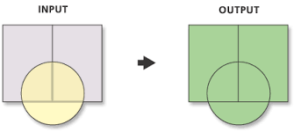
Processing Tools
Union:

Slide 9
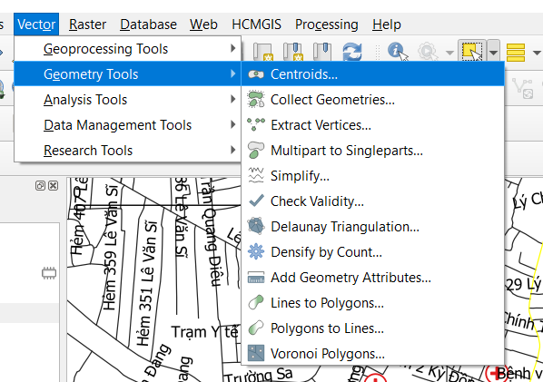
Geometry Tools

Slide 10
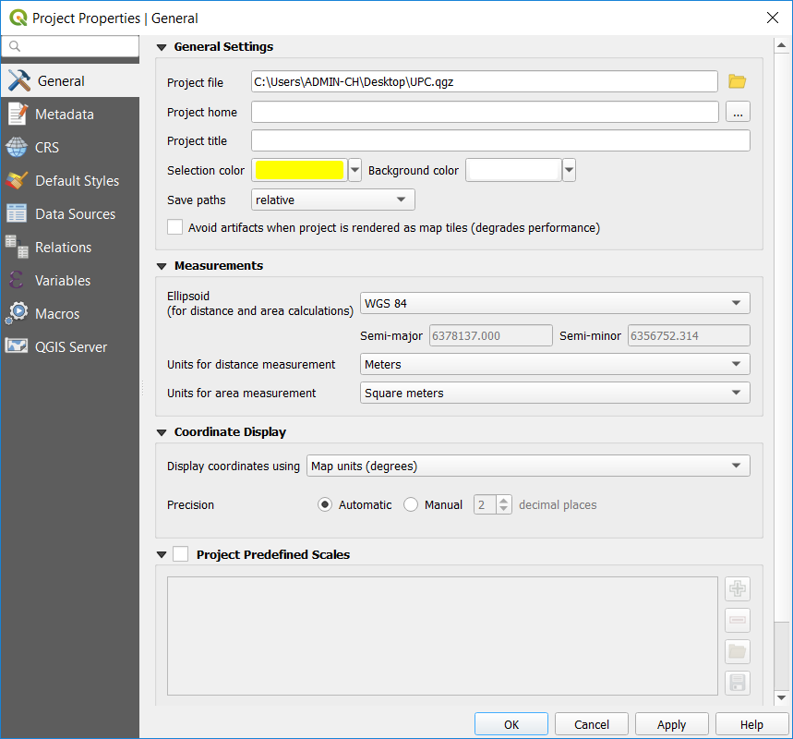
Geometry Tools
Set measurement unit to meter

Slide 11
Processing Tools
Spatial Join: Join features based on their locations
E.x 1: Auto update District name for hospitals base on their locations
Select by Location
E.g 1: Select all hospital within a 200m to “Lý Chính Thắng” road (buffer the selected road with 100m buffer size and then using Select by Location: within)

Slide 12
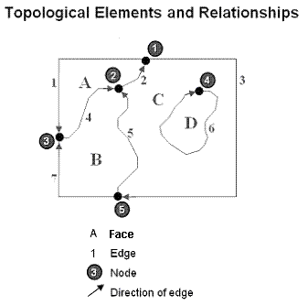
Processing Tools
Topology:
A set of rules and behaviors that model how points, lines, and polygons share coincident geometry.
A key requirement for GIS data management and integrity
Ensure data quality of the spatial relationships and to aid in data compilation
Represent spatial objects (point, line, and area features) as an underlying graph of topological primitives—nodes, faces, and edges
Ex:
Adjacent features, such as two counties, will have a common boundary between them. They share this edge.
The set of county polygons within each state must completely cover the state polygon and share edges with the state boundary.

Slide 13
Processing Tools
Topology:
Manage coincident geometry (constrain how features share geometry). For example, adjacent polygons, such as parcels, have shared edges; street centerlines and the boundaries of census blocks have coincident geometry; adjacent soil polygons share edges; etc.
Define and enforce data integrity rules (such as no gaps should exist between parcel features, parcels should not overlap, road centerlines should connect at their endpoints).
Support topological relationship queries and navigation (for example, to provide the ability to identify adjacent and connected features, find the shared edges, and navigate along a series of connected edges).
Support sophisticated editing tools that enforce the topological constraints of the data model (such as the ability to edit a shared edge and update all the features that share the common edge).

Slide 14
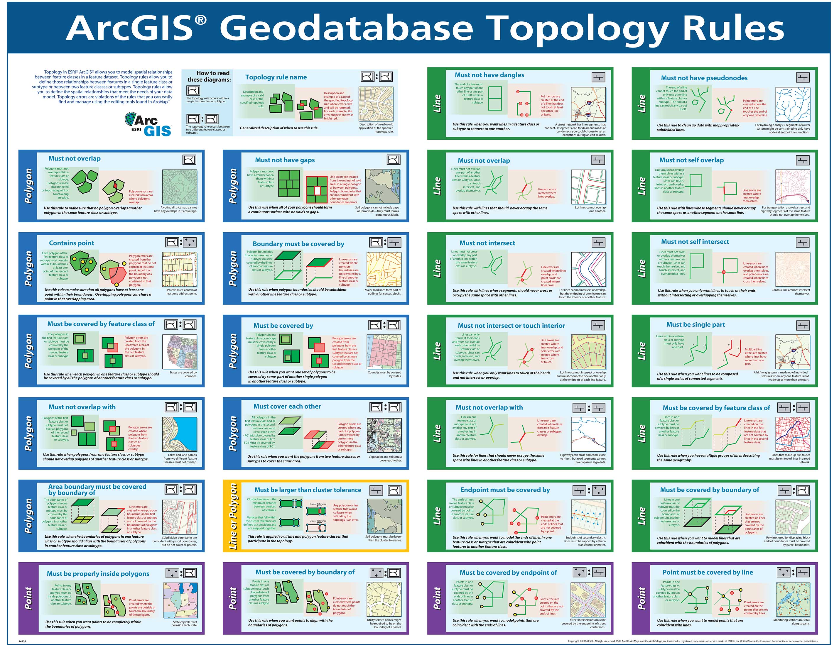
Processing Tools

Slide 15
Processing Tools
Check Validity Tool: looks for geometry errors
Why use Check Validity:
Problems when running Spatial Analysis with invalid geometry
→ Should check validity and fix geometry errors before running Spatial Analysis

Slide 16
Exercises
Create new shapefiles just contains roads and hospitals in a chosen ward (E.g: ‘Phường 7’)
Merge all Wards to make a new unique polygon called District 3
Create minimum bounding geometry for all hospitals

Slide 17
Keep Calm and enjoy Learning!
https://hcmgis.vn
HCMGIS – GIS for the City, GIS for the Community

